Slide 1
Web scraping to gain company insights
Scrape and analyze customer review data to uncover findings for British Airways
source: https://www.airlinequality.com/airline-reviews/british-airways
Github : https://github.com/IchfanKurniawan/british-airways-intern-project

Slide 2
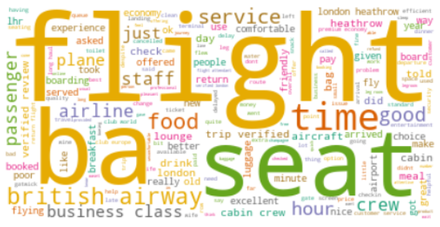
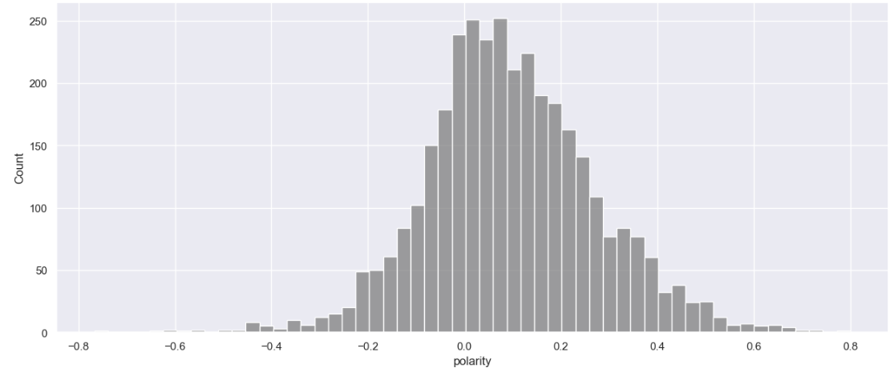
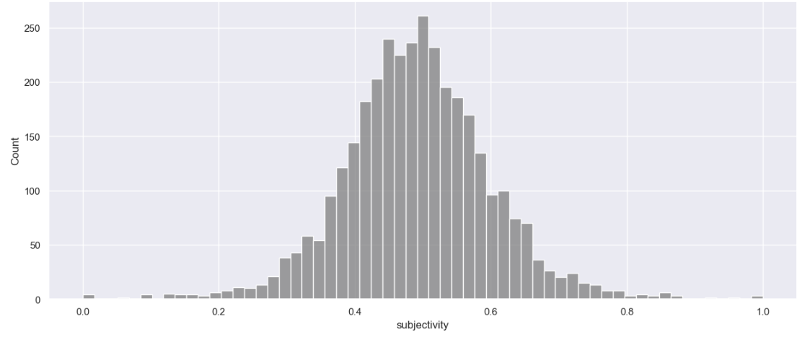
Wordcloud
Review Rating Summary
4.85 / 10
2.95 / 5
3.28 / 5
2.74 / 5
2.84 / 5
2.74 / 5
2.65 / 5
1.93 / 5
Topic Modeling
Overall Rating
Seat Comfort
Cabin Staff Service
Food & Beverages
Ground Service
Value for Money
Inflight Entertainment
Wifi & Connection
Topic 1: Flight Experience
Topic 2: Facilities
Sentiment Analysis
0.1 on polarity
It shows how positive or negative of word & it is slightly positive
0.5 on subjectivity
It shows how subjective, or opinionated & it is balance

